Slide 1

Prediction of Price Fluctuation of Used Cellphones on Amazon by Twitter
----Tonghe Zhan, Qingyuan Wen
10/08/2013

Slide 2
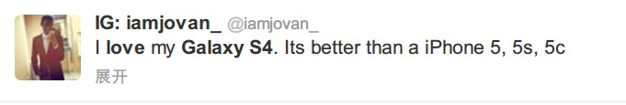
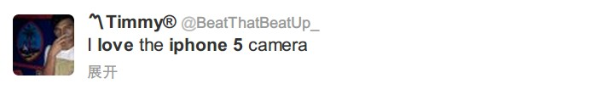
Problem statement
People want to know the trend of certain used cellphone to choose the best time to buy it from 3rd party on Amazon.

Slide 3
Hypothesis
The comments of cellphones on Twitter will affect the price of the used cellphone from 3rd party on Amazon.

Slide 4
Overview of the method
Using Twitter sentiment analysis to classify the evaluation of cellphones from tweets.
Using an extension of Chrome named the Camelizer, a Amazon price tracker, to support our work.

Slide 5
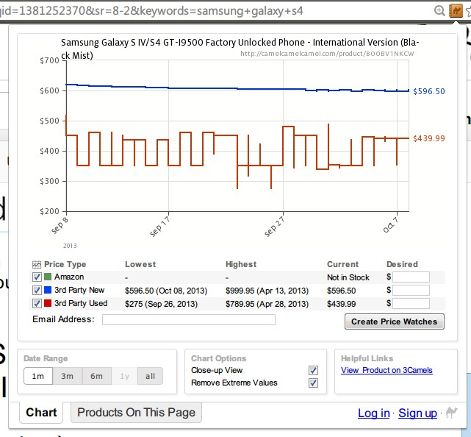
Chart from Camelizer

Slide 6
Data
How many: all the related tweets in two weeks;
Where: Twitter
Attributes: those tweets give comments to cellphones.

Slide 7
Related work
Sentiment classification method.
‘Thumbs up? Sentiment Classification using Machine Learning Techniques’
We focus on the used items market on Amazon.

Slide 8
Timeline
10/15: Learn needed skills of Python
10/22: Data collected
10/29: Baseline method implemented
11/05: Proposed method implemented
11/12: Analysis of results
11/19: Presentations
11/26: Write up of results

